Slide 1
Topics to discuss
study questions/hypotheses/objectives
data quality criteria
minimum amount/coverage of data
unpublished/raw data
correlation exists → what is the mechanism
next steps

Slide 2
Data inclusion criteria
Published data
filter type < 0.7 um
Storage (not frozen)
equipment and analytical method
supplementary data (date, location etc.)
No acidification

Slide 3
Extrapolation of a(λ)
multiple wavelengths used → need for a method to extrapolate to one wavelength used in the study
error introduced by this procedure should be quantified

Slide 4
Asking for original data
pros:
likely to get much more data
access to other parameters (salinity, pH, temperature etc.)
cons
may cause authorship issues
may delay manuscript process

Slide 5
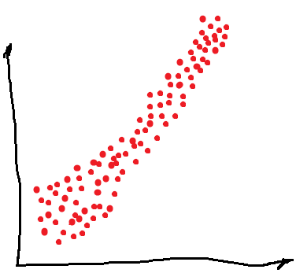
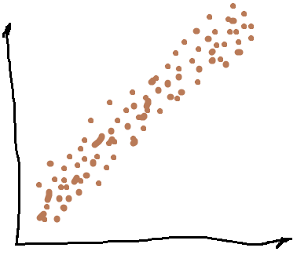
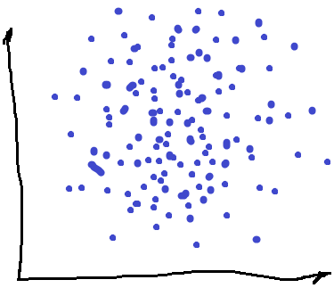
Tentative plots I
FRESHWATER
ALL DATA
a_{(CDOM)}
DOC concentration
a_{(CDOM)}
MARINE
a_{(CDOM)}
DOC concentration
DOC concentration

Slide 6
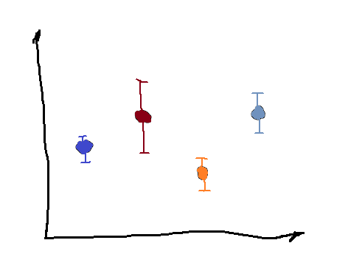
Tentative plots II
Slope / Intercept / R²
Slope / Intercept / R²
Spring
Summer
Autumn
Winter
Ocean
Coastal
River
Lake

Slide 7
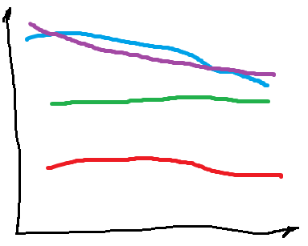
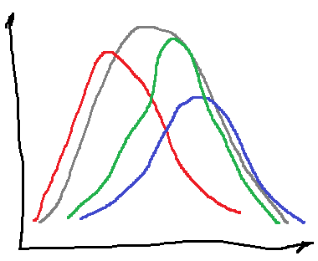
Tentative plots III
R²
Density / Count
Wavelength (nm)
Slope / Intercept / R²

Slide 8
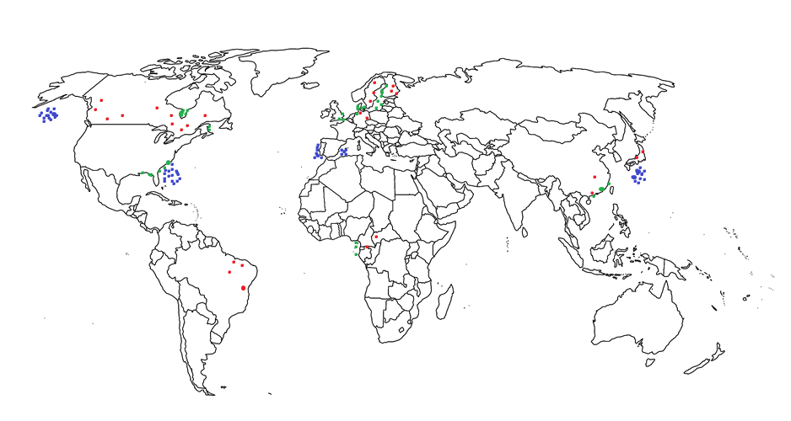
Tentative plots IV

